Slide 1

“ AUTOMATION OF ONLINE BUS RESERVATION”
Project Supervisor: Mrs. Ramya G Franklin, M.E.
Name of the Student: SOMU.K.B
Register Number: 39110958

Slide 2
Presentation Outline
Course Certificate
Introduction
Objectives
Module Implementation
Methodology
Results and Discussions
Conclusion
References

Slide 3
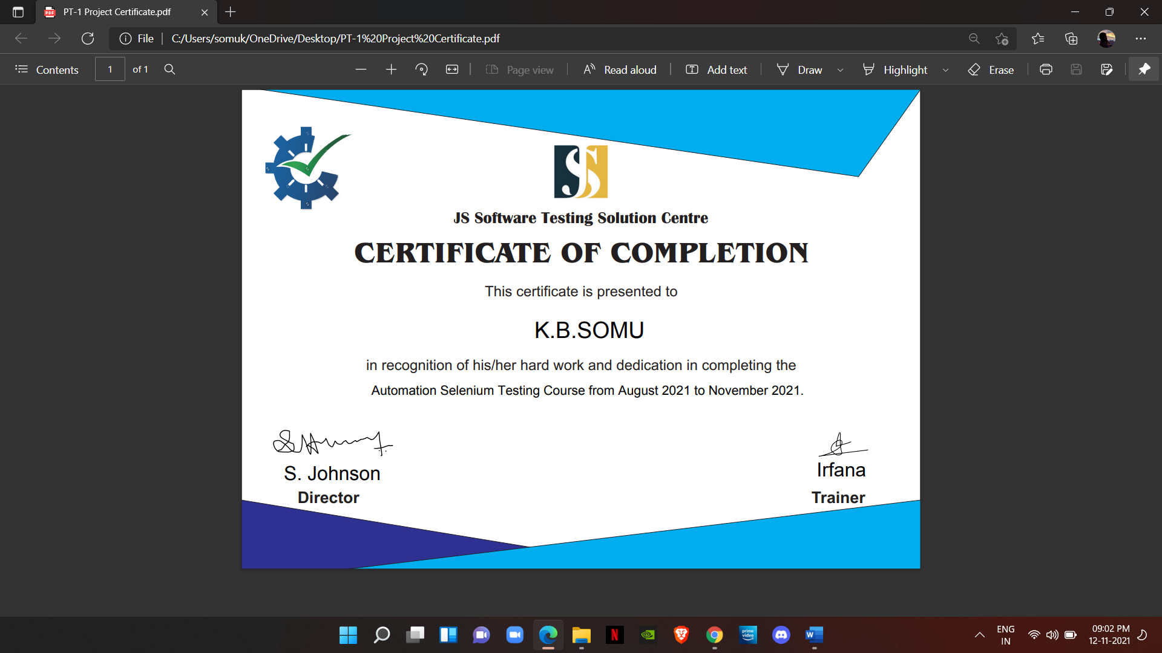
Course Certificate

Slide 4
Introduction
Selenium is a robust set of took that supports rapid development of test automation for web-based applications.
Selenium provides a rich set of testing functions specifically geared to the needs of testing of a web application.
Selenium operations are highly flexible, allowing many options for locating UI elements and comparing expected test results against actual application behaviour.

Slide 5
Objectives
Project objective
The objective of “Automation online bus reservation” is to easily track the information of all customers, departure bus station and seat information and bus destination
Scope of project
This system is helpful to business owners to maintain their business by using this web application. Owner every moment check the departure information and seats booking information and also help to keeping record of every transaction by using this application not only business owner but also general user using this web page for the purpose of booking the tickets online general user no need to go bus counter to book tickets they can book ticket remotely anywhere in the world by fulfill this instruction.

Slide 6
Project Implementation
In the implementation phase all the programs are written database is created user optimal document is written user are trained and the system tested with optimal data the implementation is carried out with the result that have been obtained from the flexibility study and analysis the system is implemented by finishing the project with the help of appropriate tools that been suggested and are loaded in to the server then the system is tested with appropriate data input to check the successful Ness of the system this being carried out by inputting data that are of rare to inputted then the administrator will be trained for optimal functionality to control and maintain system at the later stage

Slide 7
Project Implementation
Installation procedure
The installation procedure is a set of steps that have to be carried out in specific order for the proper installation off the developed system. Being a web page it requires a fixed space in the server. The first phase is allocation of system in the space provided in the server. The system is stored in root directory. This directory is uploaded into the server space that have been allocated.
Implementation plan
The first phase in the implementation of a system is a plan to make it implement. For proper implementation the plan is a pre-requisite and is known as pre-implementation activity. It is in the steps that various activities which are required for implementation a system are identified and their sequence and relation to each other is deserved. In the steps various other estimates like time required for each activity.

Slide 8
Methodology
First goes to online ticket booking website.
Fills the from where box.
Fills the to where box.
Clicks on the calendar .
Chooses a random future date from the calendar
Clicks on search buses.
First pop up will appear and closes the first popup.
Second pop up will appear and closes the second popup.

Slide 9
Methodology
The list of buses will we shown which are present in from box and to box.
Picks the first bus in the list and takes details of the bus.
Details like boarding point and dropping point and the fare for a person in that bus and the bus facilities and amenities.
Prints these details in eclipse console.

Slide 10
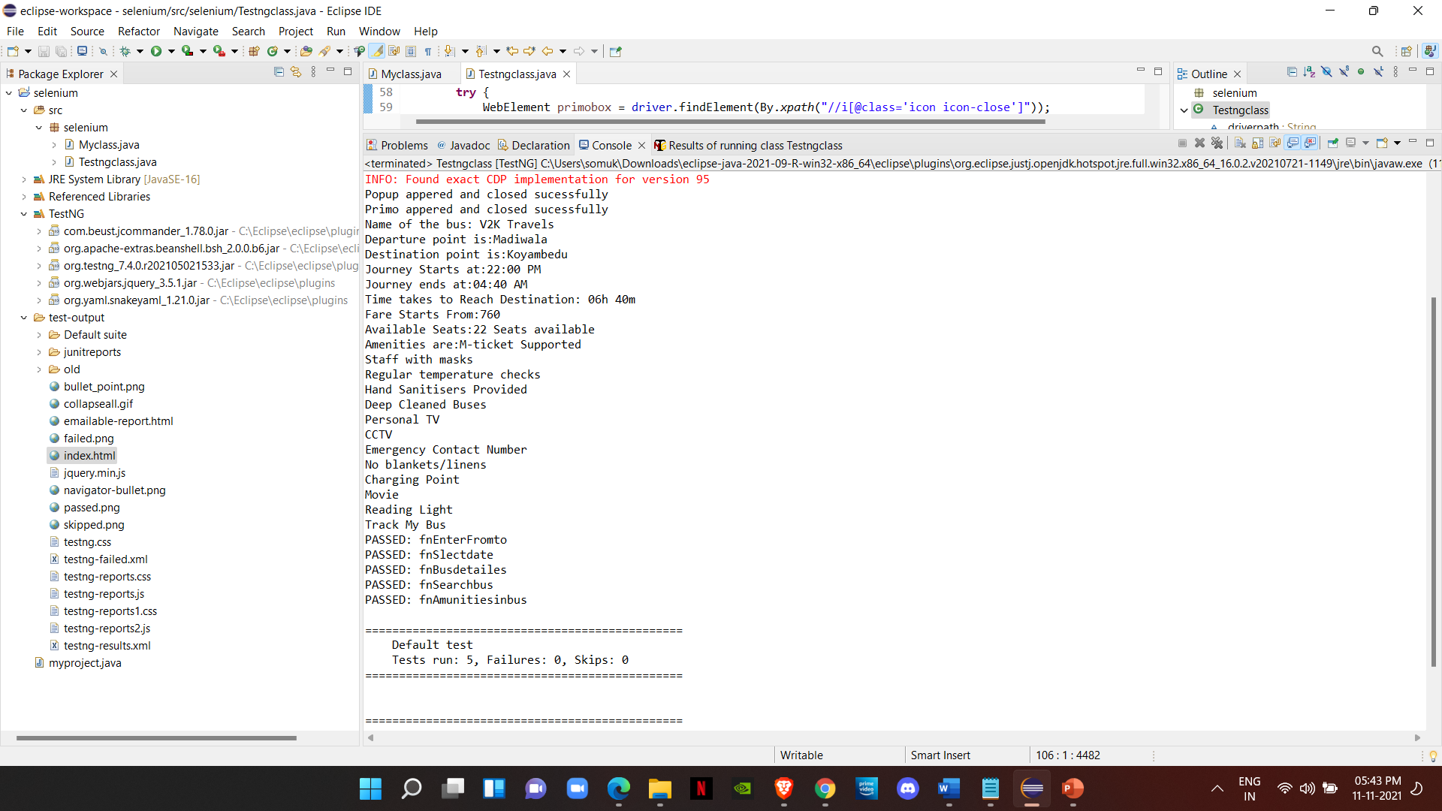
Results and Output

Slide 11
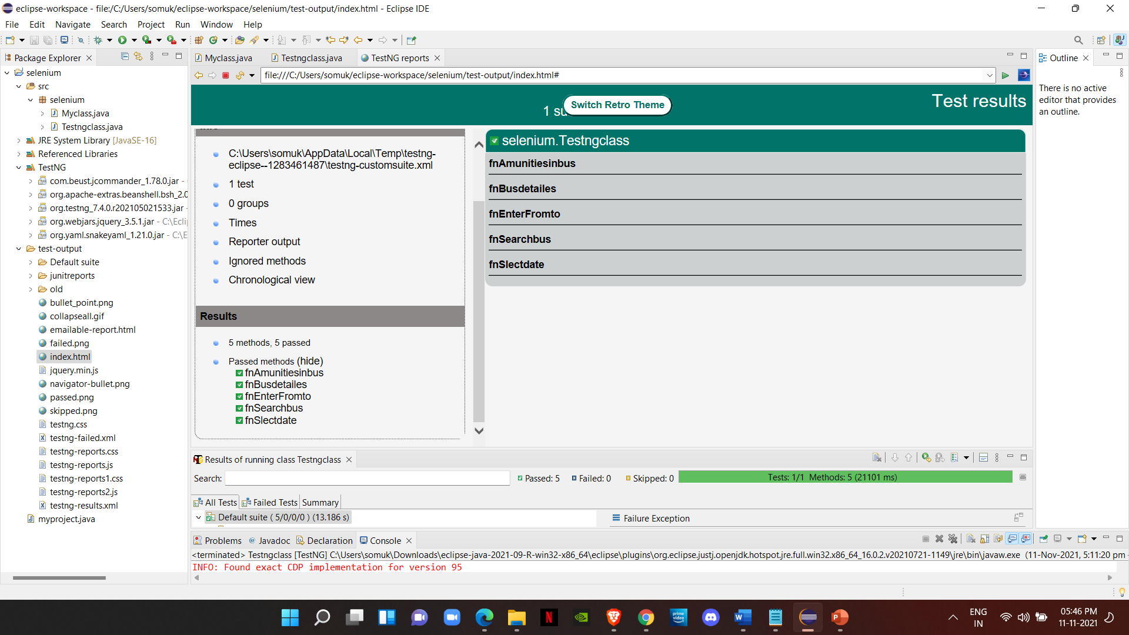
Results and Output

Slide 12
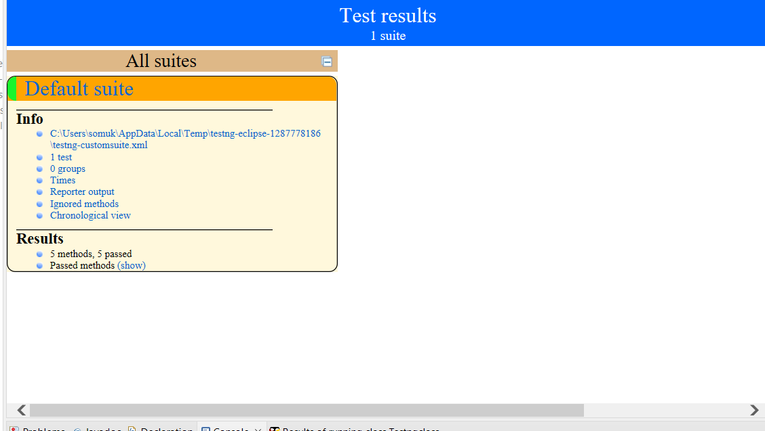
Results and Output

Slide 13
Conclusion
We have completed the program and program executed successfully.

Slide 14
References
Selenium WebDriver in Eclipse IDE :- https://youtu.be/FVwSjBXb20o Selenium testing tools :- https://www.geeksforgeeks.org/selenium-basics-components-features-uses-and-limitations/

Slide 15
THANK YOU

